Slide 1
INDEX
두 개 이상의 테이블에서 조회
계층형 쿼리(셀프 조인 고급)

Slide 2
두 개 이상의 테이블 조회
조인(JOIN)의 개념
조인(JOIN)의 구현
내부 조인
크로스 조인
외부 조인
셀프 조인

Slide 3
1. 조인(JOIN)의 개념
조인(JOIN) 이란?
여러 개의 테이블에서 원하는 자료를 조회
=> 정규화로 나누어진 테이블, 칼럼을 다시 모으는 것
사원번호, 사원명, 부서코드, 부서명, 관리자사원번호
를 조회 하려면? => 사원테이블, 부서테이블을 이용
조인(JOIN) 개념
조인 연산 = 카티션 곱 + 선택 연산의 형태
SELECT EMPLOYEE_ID, FIRST_NAME, A.DEPARTMENT_ID,
B.DEPARTMENT_ID, DEPARTMENT_NAME, MANAGER_ID
FROM EMPLOYEES A, DEPARTMENTS B /*카티션곱*/
WHERE A.DEPARTMENT_ID=B.DEPARTMENT_ID; /*선택연산*/

Slide 4
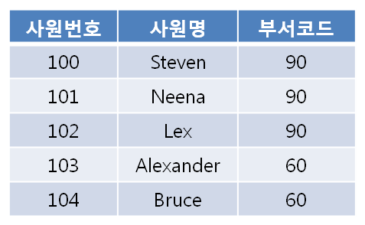
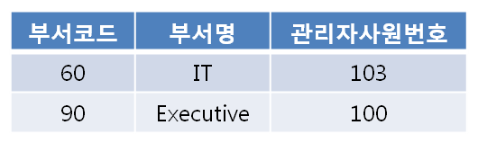
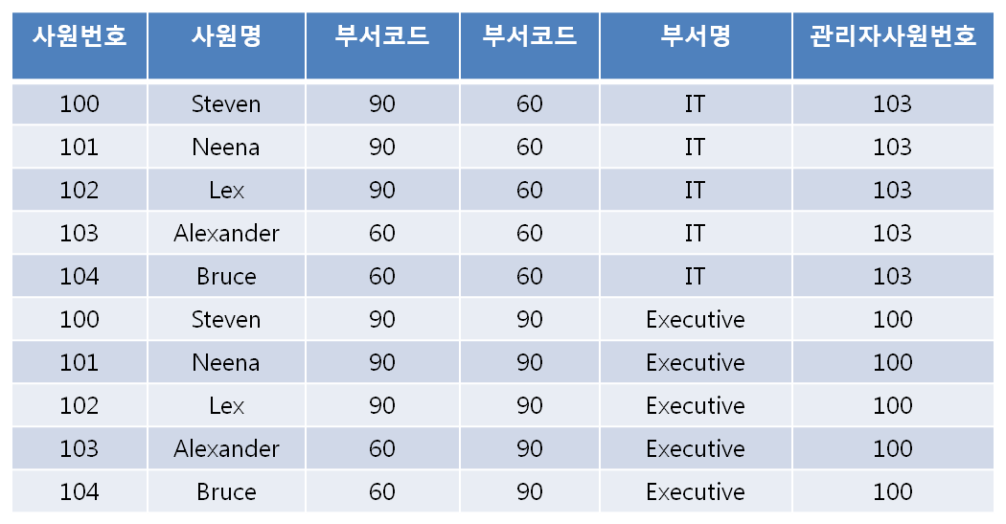
<사원 테이블>
<부서 테이블>
카티션 곱
선택연산

Slide 5
2. 조인(JOIN)의 구현
ANSI SQL 문법
FROM 절에 데이블 마다 조인관계를 JOIN과 ON 으로 표현
SELECT EMPLOYEE_ID, FIRST_NAME, A.DEPARTMENT_ID,
B.DEPARTMENT_ID, DEPARTMENT_NAME, MANAGER_ID
FROM EMPLOYEES A JOIN DEPARTMENTS B
ON A.DEPARTMENT_ID=B.DEPARTMENT_ID;
오라클 SQL 문법
FROM 절에 조인에 관련된 테이블 나열
WHERE 절에 조인관계 선언
SELECT EMPLOYEE_ID, FIRST_NAME, A.DEPARTMENT_ID,
B.DEPARTMENT_ID, DEPARTMENT_NAME, MANAGER_ID
FROM EMPLOYEES A, DEPARTMENTS B
WHERE A.DEPARTMENT_ID=B.DEPARTMENT_ID;

Slide 6
3. 내부(INNER) 조인(1/2)
오라클 SQL 문법 (2개 테이블)
SELECT EMPLOYEE_ID, FIRST_NAME, A.DEPARTMENT_ID,
B.DEPARTMENT_ID, DEPARTMENT_NAME,
B.MANAGER_ID
FROM EMPLOYEES A, DEPARTMENTS B
WHERE A.DEPARTMENT_ID=B.DEPARTMENT_ID;
ANSI SQL 문법 (2개 테이블)
SELECT EMPLOYEE_ID, FIRST_NAME, A.DEPARTMENT_ID,
B.DEPARTMENT_ID, DEPARTMENT_NAME,
B.MANAGER_ID
FROM EMPLOYEES A [INNER] JOIN DEPARTMENTS B
ON A.DEPARTMENT_ID=B.DEPARTMENT_ID;

Slide 7
3. 내부(INNER) 조인(2/2)
오라클 SQL 문법 (3개 테이블)
SELECT EMPLOYEE_ID, FIRST_NAME, A.DEPARTMENT_ID,
A.JOB_ID, B.DEPARTMENT_ID, DEPARTMENT_NAME,
MANAGER_ID, C.JOB_ID, C.JOB_TITLE
FROM EMPLOYEES A, DEPARTMENTS B, JOBS C
WHERE A.DEPARTMENT_ID=B.DEPARTMENT_ID
AND A.JOB_ID = C.JOB_ID;
ANSI SQL 문법 (3개 테이블)
SELECT EMPLOYEE_ID, FIRST_NAME, A.DEPARTMENT_ID,
A.JOB_ID, B.DEPARTMENT_ID, DEPARTMENT_NAME,
MANAGER_ID, C.JOB_ID, C.JOB_TITLE
FROM EMPLOYEES A JOIN DEPARTMENTS B
ON A.DEPARTMENT_ID=B.DEPARTMENT_ID
JOIN JOBS C ON A.JOB_ID = C.JOB_ID;

Slide 8
4. 크로스(CROSS) 조인
ANSI SQL 문법
SELECT EMPLOYEE_ID, FIRST_NAME, A.DEPARTMENT_ID,
B.DEPARTMENT_ID, DEPARTMENT_NAME,
B.MANAGER_ID
FROM EMPLOYEES A CROSS JOIN DEPARTMENTS B;
오라클 SQL 문법
SELECT EMPLOYEE_ID, FIRST_NAME, A.DEPARTMENT_ID,
B.DEPARTMENT_ID, DEPARTMENT_NAME,
B.MANAGER_ID
FROM EMPLOYEES A, DEPARTMENTS B;

Slide 9
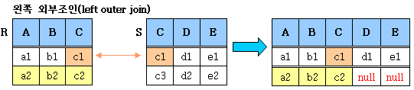
5. 외부(OUTER) 조인(1/3)
ANSI SQL 문법
SELECT EMPLOYEE_ID, FIRST_NAME, DEPARTMENT_NAME
FROM EMPLOYEES A
LEFT [OUTER] JOIN DEPARTMENTS B
ON A.DEPARTMENT_ID = B.DEPARTMENT_ID;
오라클 SQL 문법
SELECT EMPLOYEE_ID, FIRST_NAME, DEPARTMENT_NAME
FROM EMPLOYEES A, DEPARTMENTS B
WHERE A.DEPARTMENT_ID = B.DEPARTMENT_ID (+);

Slide 10
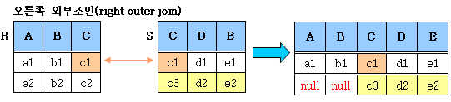
5. 외부(OUTER) 조인(2/3)
ANSI SQL 문법
SELECT EMPLOYEE_ID, FIRST_NAME, DEPARTMENT_NAME
FROM EMPLOYEES A
RIGHT [OUTER] JOIN DEPARTMENTS B
ON A.DEPARTMENT_ID = B.DEPARTMENT_ID;
오라클 SQL 문법
SELECT EMPLOYEE_ID, FIRST_NAME, DEPARTMENT_NAME
FROM EMPLOYEES A, DEPARTMENTS B
WHERE A.DEPARTMENT_ID (+) = B.DEPARTMENT_ID;

Slide 11
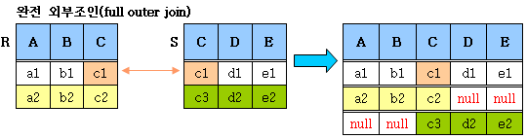
5. 외부(OUTER) 조인(3/3)
ANSI SQL 문법
SELECT EMPLOYEE_ID, FIRST_NAME, DEPARTMENT_NAME
FROM EMPLOYEES A
FULL [OUTER] JOIN DEPARTMENTS B
ON A.DEPARTMENT_ID = B.DEPARTMENT_ID;
오라클 SQL 문법
표현방법 없음
LEFT OUTER JOIN과 RIGHT OUTER JOIN 결합으로 표현

Slide 12
--일반 조인
--106건
SELECT COUNT(*)
FROM EMPLOYEES A
JOIN DEPARTMENTS B
ON A.DEPARTMENT_ID = B.DEPARTMENT_ID;

Slide 13
--LEFT OUTER JOIN
--107건
SELECT COUNT(*)
FROM EMPLOYEES A
LEFT JOIN DEPARTMENTS B
ON A.DEPARTMENT_ID = B.DEPARTMENT_ID;

Slide 14
--대상건
SELECT EMPLOYEE_ID, FIRST_NAME, A.DEPARTMENT_ID, // ANSI
B.DEPARTMENT_ID, DEPARTMENT_NAME
FROM EMPLOYEES A
LEFT OUTER JOIN DEPARTMENTS B
ON A.DEPARTMENT_ID = B.DEPARTMENT_ID
ORDER BY DEPARTMENT_NAME NULLS FIRST;
SELECT EMPLOYEE_ID, FIRST_NAME, A.DEPARTMENT_ID, // Oracle
B.DEPARTMENT_ID, DEPARTMENT_NAME
FROM EMPLOYEES A,
DEPARTMENTS B
WHERE A.DEPARTMENT_ID = B.DEPARTMENT_ID (+)
ORDER BY DEPARTMENT_NAME NULLS FIRST;

Slide 15
--RIGHT OUTER JOIN
--122건
SELECT COUNT(*)
FROM EMPLOYEES A
RIGHT OUTER JOIN DEPARTMENTS B
ON A.DEPARTMENT_ID = B.DEPARTMENT_ID;

Slide 16
--대상건
SELECT EMPLOYEE_ID, FIRST_NAME, A.DEPARTMENT_ID,
B.DEPARTMENT_ID, DEPARTMENT_NAME
FROM EMPLOYEES A
RIGHT OUTER JOIN DEPARTMENTS B
ON A.DEPARTMENT_ID = B.DEPARTMENT_ID
ORDER BY EMPLOYEE_ID NULLS FIRST;
SELECT EMPLOYEE_ID, FIRST_NAME, A.DEPARTMENT_ID,
B.DEPARTMENT_ID, DEPARTMENT_NAME
FROM EMPLOYEES A,
DEPARTMENTS B
WHERE A.DEPARTMENT_ID (+) = B.DEPARTMENT_ID
ORDER BY EMPLOYEE_ID NULLS FIRST;

Slide 17
--FULL OUTER JOIN
--123건
SELECT COUNT(*)
FROM EMPLOYEES A
FULL OUTER JOIN DEPARTMENTS B
ON A.DEPARTMENT_ID = B.DEPARTMENT_ID;
--대상건
SELECT EMPLOYEE_ID, FIRST_NAME, A.DEPARTMENT_ID, B.DEPARTMENT_ID, DEPARTMENT_NAME
FROM EMPLOYEES A
FULL OUTER JOIN DEPARTMENTS B
ON A.DEPARTMENT_ID = B.DEPARTMENT_ID
ORDER BY DEPARTMENT_NAME NULLS FIRST,
EMPLOYEE_ID NULLS FIRST;

Slide 18
--오류
SELECT EMPLOYEE_ID, FIRST_NAME, A.DEPARTMENT_ID, B.DEPARTMENT_ID, DEPARTMENT_NAME
FROM EMPLOYEES A, DEPARTMENTS B
WHERE A.DEPARTMENT_ID (+) = B.DEPARTMENT_ID (+);
--두 조인을 하고 싶은 경우.. 다음 페이지

Slide 19
SELECT EMPLOYEE_ID, FIRST_NAME,
A.DEPARTMENT_ID, B.DEPARTMENT_ID,
DEPARTMENT_NAME
FROM EMPLOYEES A, DEPARTMENTS B
WHERE A.DEPARTMENT_ID = B.DEPARTMENT_ID (+)
UNION -- 결합 연산자
SELECT EMPLOYEE_ID, FIRST_NAME,
A.DEPARTMENT_ID, B.DEPARTMENT_ID,
DEPARTMENT_NAME
FROM EMPLOYEES A, DEPARTMENTS B
WHERE A.DEPARTMENT_ID (+) = B.DEPARTMENT_ID
ORDER BY DEPARTMENT_NAME NULLS FIRST,
EMPLOYEE_ID NULLS FIRST;

Slide 20
6. 셀프(SELF) 조인
같은 테이블에서 일치하는 값을 조사 할 때
SELECT A.EMPLOYEE_ID, A.FIRST_NAME, A.MANAGER_ID,
B.EMPLOYEE_ID, B.FIRST_NAME, B.MANAGER_ID
FROM EMPLOYEES A, EMPLOYEES B
WHERE A.MANAGER_ID = B.EMPLOYEE_ID;
계층적인 구조를 이용할 때
SELECT A.EMPLOYEE_ID, A.FIRST_NAME, A.MANAGER_ID
FROM EMPLOYEES A
START WITH A.MANAGER_ID IS NOT NULL
CONNECT BY PRIOR A.MANAGER_ID = A.EMPLOYEE_ID;

Slide 21
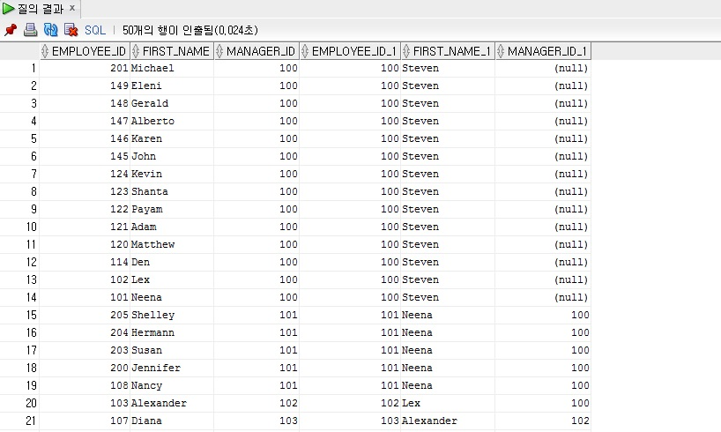
--SELF JOIN
SELECT A.EMPLOYEE_ID, A.FIRST_NAME, A.MANAGER_ID, B.EMPLOYEE_ID, B.FIRST_NAME, B.MANAGER_ID
FROM EMPLOYEES A, EMPLOYEES B
WHERE A.MANAGER_ID = B.EMPLOYEE_ID;
MANAGER를 검색하고 싶은 경우로
MANAGER_ID와 EMPLOYEE_ID가 같은 경우에 해당한다

Slide 22
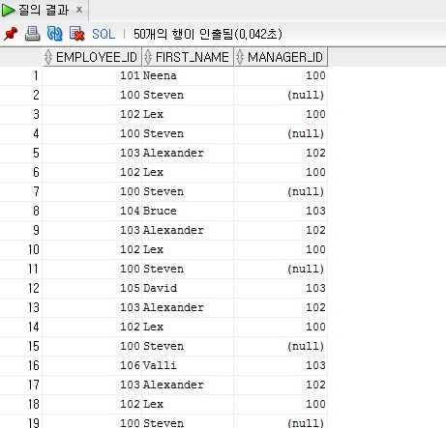
SELECT A.EMPLOYEE_ID, A.FIRST_NAME, A.MANAGER_ID –-계층 형 구조
FROM EMPLOYEES A
START WITH A.MANAGER_ID IS NOT NULL
CONNECT BY PRIOR A.MANAGER_ID = A.EMPLOYEE_ID;
MANAGER를 따라서 계층 형으로
계속해서 검색하고 싶은 경우에
해당한다
(다음 페이지에 계속)

Slide 23
계층 형 쿼리(셀프 조인 고급)
계층형 쿼리
여러 행의 값을 한 행으로 표현
계층형 함수

Slide 24
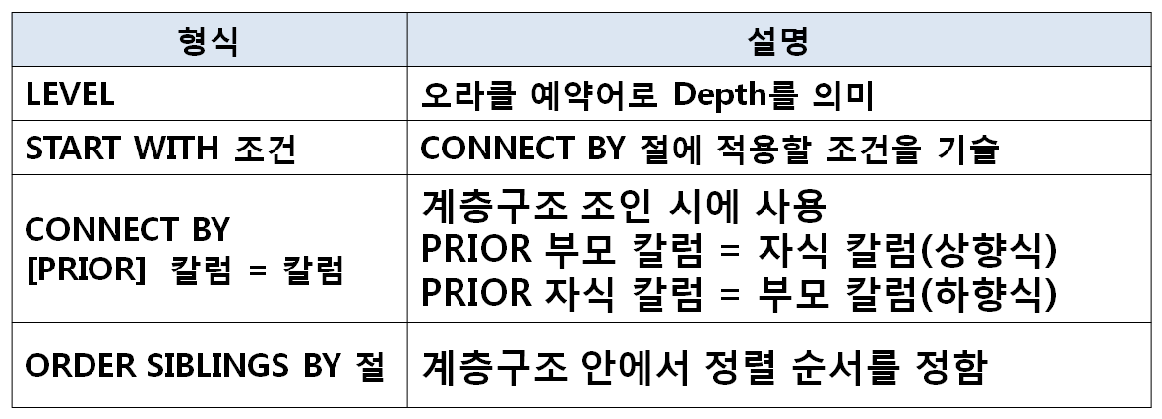
1. 계층형 쿼리 (1/2)
SELECT LEVEL, A.EMPLOYEE_ID, A.FIRST_NAME, A.SALARY,
A.MANAGER_ID, B.FIRST_NAME AS MANAGER_NAME
FROM EMPLOYEES A, EMPLOYEES B
WHERE A.MANAGER_ID = B.EMPLOYEE_ID (+)
CONNECT BY A.MANAGER_ID = A.EMPLOYEE_ID;

Slide 25
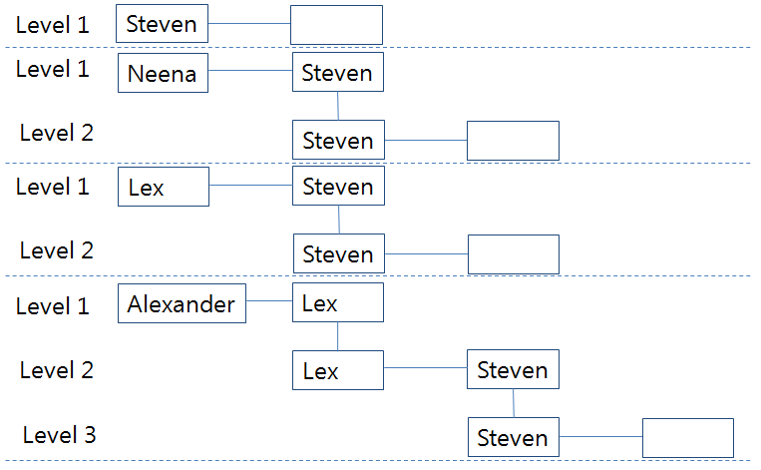
1. 계층형 쿼리 (2/3)
상향식(직원 -> 상위메니저-> 차 상위 메니저...)
SELECT LEVEL, A.EMPLOYEE_ID, A.FIRST_NAME, A.SALARY,
A.MANAGER_ID, B.FIRST_NAME AS MANAGER_NAME
FROM EMPLOYEES A, EMPLOYEES B
WHERE A.MANAGER_ID = B.EMPLOYEE_ID (+)
CONNECT BY PRIOR A.MANAGER_ID = A.EMPLOYEE_ID;

Slide 26
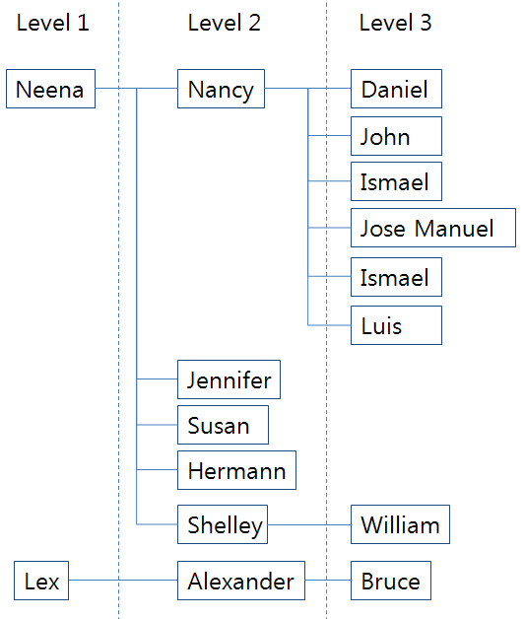
1. 계층형 쿼리 (3/3)
하향식(직원 -> 하위 직원-> 차 하위 직원...)
SELECT LEVEL, A.EMPLOYEE_ID, A.FIRST_NAME, A.SALARY,
A.MANAGER_ID, B.FIRST_NAME AS MANAGER_NAME
FROM EMPLOYEES A, EMPLOYEES B
WHERE A.MANAGER_ID = B.EMPLOYEE_ID (+)
CONNECT BY A.MANAGER_ID = PRIOR A.EMPLOYEE_ID;

Slide 27
2. 여러 행의 값을 한 행으로 표현
숫자형 처리
그룹 함수를 이용한 처리
SELECT FIRST_NAME, LAST_NAME, SUM(SALARY)
FROM EMPLOYEES
GROUP BY FIRST_NAME, LAST_NAME
문자형 처리
상황에 따라 처리 방법이 다양함
- 그룹 함수 (결과 ROW의 수를 명확히 아는경우)
- WMSYS 함수 (WM_CONCAT : 11g 까지 사용)
- 오라클 함수 (LISTAGG–11g 이상, XMLAGG-10g 이상)
- 계층형 함수 (SYS_CONNECT_BY_PATH)

Slide 28
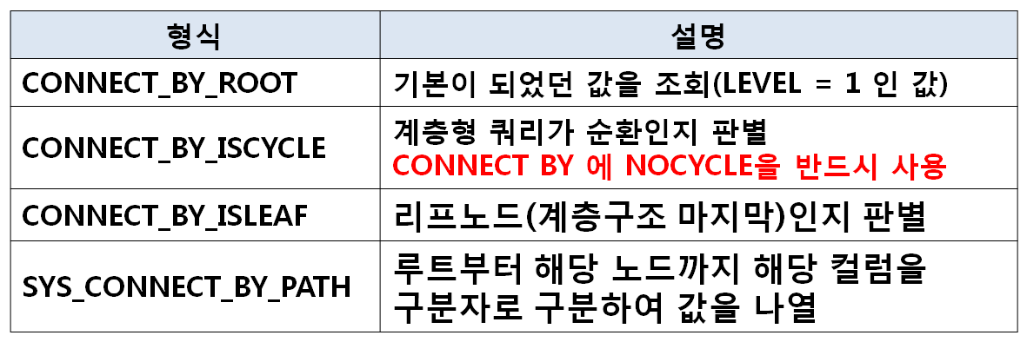
3. 계층형 함수
SELECT LEVEL, EMPLOYEE_ID, MANAGER_ID,
CONNECT_BY_ROOT(EMPLOYEE_ID) AS ROOT_ID,
SUBSTR(SYS_CONNECT_BY_PATH(FIRST_NAME, ', '), 2),
CONNECT_BY_ISCYCLE,
CONNECT_BY_ISLEAF
FROM EMPLOYEES
CONNECT BY NOCYCLE PRIOR MANAGER_ID = EMPLOYEE_ID;

Slide 29
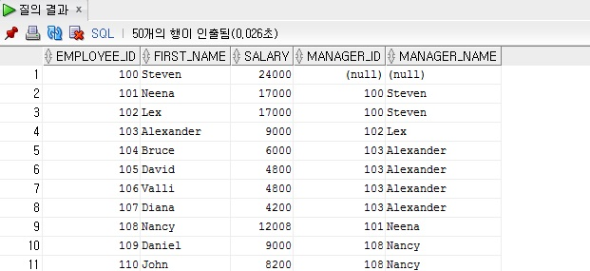
--일반 셀프조인
SELECT A.EMPLOYEE_ID, A.FIRST_NAME, A.SALARY, A.MANAGER_ID, B.FIRST_NAME AS MANAGER_NAME
FROM EMPLOYEES A, EMPLOYEES B
WHERE A.MANAGER_ID = B.EMPLOYEE_ID (+)
ORDER BY EMPLOYEE_ID;
-- 매니저가 누구인지 알아보는 경우.

Slide 30
--계층형 쿼리(정렬)
SELECT LEVEL, A.EMPLOYEE_ID, A.FIRST_NAME, A.SALARY, A.MANAGER_ID, B.FIRST_NAME AS MANAGER_NAME
FROM EMPLOYEES A, EMPLOYEES B
WHERE A.MANAGER_ID = B.EMPLOYEE_ID (+)
CONNECT BY A.MANAGER_ID = A.EMPLOYEE_ID
ORDER BY EMPLOYEE_ID;

Slide 31
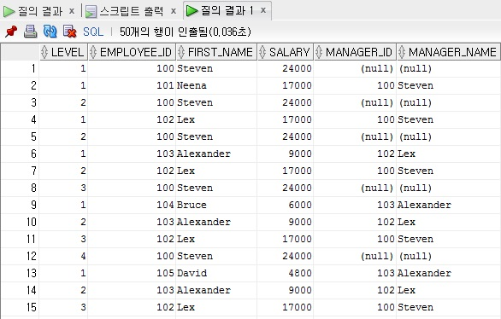
--계층형 쿼리(다단계)
SELECT LEVEL, A.EMPLOYEE_ID, A.FIRST_NAME, A.SALARY,
A.MANAGER_ID, B.FIRST_NAME AS MANAGER_NAME
FROM EMPLOYEES A, EMPLOYEES B
WHERE A.MANAGER_ID = B.EMPLOYEE_ID (+)
CONNECT BY PRIOR A.MANAGER_ID = A.EMPLOYEE_ID; // 상향식

Slide 32
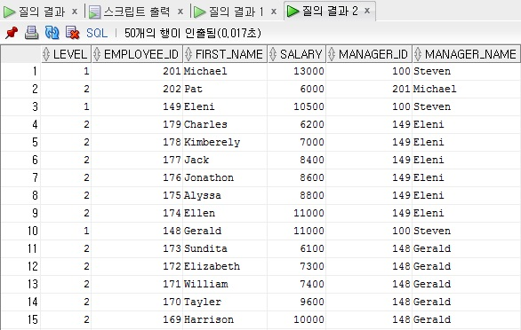
SELECT LEVEL, A.EMPLOYEE_ID, A.FIRST_NAME, A.SALARY,
A.MANAGER_ID, B.FIRST_NAME AS MANAGER_NAME
FROM EMPLOYEES A, EMPLOYEES B
WHERE A.MANAGER_ID = B.EMPLOYEE_ID (+)
CONNECT BY A.MANAGER_ID = PRIOR A.EMPLOYEE_ID; // 하향식
-- 계층 형 쿼리에서는 PRIOR가 중요한 역할을 한다.

Slide 33
--다단계 계층형 -> 단일
SELECT LEVEL, A.EMPLOYEE_ID, A.FIRST_NAME, A.SALARY, A.MANAGER_ID, B.FIRST_NAME AS MANAGER_NAME
FROM EMPLOYEES A, EMPLOYEES B
WHERE A.MANAGER_ID = B.EMPLOYEE_ID (+)
AND LEVEL = 1
CONNECT BY PRIOR A.MANAGER_ID = A.EMPLOYEE_ID;
-- LEVEL이 1인 내용만 보여진다.

Slide 34
--다단계 정렬(ORDER BY) 계층구조가 없어진다
SELECT LEVEL, A.EMPLOYEE_ID, A.FIRST_NAME, A.SALARY, A.MANAGER_ID, B.FIRST_NAME AS MANAGER_NAME
FROM EMPLOYEES A, EMPLOYEES B
WHERE A.MANAGER_ID = B.EMPLOYEE_ID (+)
CONNECT BY PRIOR A.MANAGER_ID = A.EMPLOYEE_ID
ORDER BY FIRST_NAME;
--다단계 정렬(ORDER SIBLINGS BY) 알파벳 순으로 정렬됨과 계층적 나온다
SELECT LEVEL, A.EMPLOYEE_ID, A.FIRST_NAME, A.SALARY,
A.MANAGER_ID, B.FIRST_NAME AS MANAGER_NAME
FROM EMPLOYEES A, EMPLOYEES B
WHERE A.MANAGER_ID = B.EMPLOYEE_ID (+)
CONNECT BY A.MANAGER_ID = PRIOR A.EMPLOYEE_ID
ORDER SIBLINGS BY FIRST_NAME;

Slide 35
--다단계 익히기(상향식)
SELECT LEVEL, A.EMPLOYEE_ID, A.FIRST_NAME, A.SALARY, A.MANAGER_ID, B.FIRST_NAME AS MANAGER_NAME
FROM EMPLOYEES A, EMPLOYEES B
WHERE A.MANAGER_ID = B.EMPLOYEE_ID (+)
CONNECT BY PRIOR A.MANAGER_ID = A.EMPLOYEE_ID;
--다단계 익히기(상향식-조건주기)
SELECT LEVEL, A.EMPLOYEE_ID, A.FIRST_NAME, A.SALARY, A.MANAGER_ID, B.FIRST_NAME AS MANAGER_NAME
FROM EMPLOYEES A, EMPLOYEES B
WHERE A.MANAGER_ID = B.EMPLOYEE_ID (+)
START WITH a.manager_id is not null – 매니저 아이디가 없는 사람은 배제
CONNECT BY PRIOR A.MANAGER_ID = A.EMPLOYEE_ID;

Slide 36
--다단계 익히기(하향식)
SELECT LEVEL, A.EMPLOYEE_ID, A.FIRST_NAME, A.SALARY, A.MANAGER_ID, B.FIRST_NAME AS MANAGER_NAME
FROM EMPLOYEES A, EMPLOYEES B
WHERE A.MANAGER_ID = B.EMPLOYEE_ID (+)
START WITH a.manager_id is not null
CONNECT BY A.MANAGER_ID = PRIOR A.EMPLOYEE_ID;
--다단계 익히기(하향식-정렬)
SELECT LEVEL, A.EMPLOYEE_ID, A.FIRST_NAME, A.SALARY, A.MANAGER_ID, B.FIRST_NAME AS MANAGER_NAME
FROM EMPLOYEES A, EMPLOYEES B
WHERE A.MANAGER_ID = B.EMPLOYEE_ID (+)
START WITH a.manager_id is not null – 매니저 아이디가 없는 사람은 배제
CONNECT BY A.MANAGER_ID = PRIOR A.EMPLOYEE_ID
ORDER SIBLINGS BY A.SALARY DESC; --역순으로

Slide 37
--여러 행의 값을 한 행으로 표현하기
--숫자
SELECT DEPARTMENT_ID, SUM(SALARY)
FROM EMPLOYEES
GROUP BY DEPARTMENT_ID;
--대상쿼리
SELECT DISTINCT FIRST_NAME AS NAME -- DISTINCT 중복제거
FROM EMPLOYEES
WHERE FIRST_NAME IN ('Lex', 'Neena', 'Steven')
ORDER BY NAME;

Slide 38
--DECODE 또는 CASE 를 이용하여 컬럼 분리
--DECODE
SELECT DECODE(NAME, 'Lex', NAME, '') AS NAME1
, DECODE(NAME, 'Neena', NAME, '') AS NAME2
, DECODE(NAME, 'Steven', NAME, '') AS NAME3
FROM
( --서브 쿼리(일종의 테이블)
SELECT DISTINCT FIRST_NAME AS NAME
FROM EMPLOYEES
WHERE FIRST_NAME IN ('Lex', 'Neena', 'Steven')
ORDER BY NAME
);

Slide 39
--CASE문( XXX면 NAME 으로 아니면 ‘’ )
SELECT CASE WHEN NAME = 'Lex' THEN NAME ELSE '' END AS NAME1
, CASE WHEN NAME = 'Neena' THEN NAME ELSE '' END AS NAME2
, CASE WHEN NAME = 'Steven' THEN NAME ELSE '' END AS NAME3
FROM
(
SELECT DISTINCT FIRST_NAME AS NAME
FROM EMPLOYEES
WHERE FIRST_NAME IN ('Lex', 'Neena', 'Steven')
ORDER BY NAME
);

Slide 40
--그룹 함수를 이용하여 여러 개의 행을 하나의 행으로 바꿔준다.
SELECT MAX(NAME1) || ', ' || MAX(NAME2) || ', '|| MAX(NAME3) AS NAME
FROM
(
SELECT CASE WHEN NAME = 'Lex' THEN NAME ELSE '' END AS NAME1
, CASE WHEN NAME = 'Neena' THEN NAME ELSE '' END AS NAME2
, CASE WHEN NAME = 'Steven' THEN NAME ELSE '' END AS NAME3
FROM
(
SELECT DISTINCT FIRST_NAME AS NAME
FROM EMPLOYEES
WHERE FIRST_NAME IN ('Lex', 'Neena', 'Steven')
ORDER BY NAME
)
);

Slide 41
--> 11g 부터 사용하는 LISTAGG 함수 사용(11g 에서는 4000byte 넘을때 문제 발생)
SELECT LISTAGG(NAME, ', ') WITHIN GROUP (ORDER BY NAME) AS NAME
FROM
(
SELECT DISTINCT FIRST_NAME AS NAME
FROM EMPLOYEES
WHERE FIRST_NAME IN ('Lex', 'Neena', 'Steven')
ORDER BY NAME
);

Slide 42
--> XMLAGG 사용 방법(10g부터 사용가능 - 4000byte 이상도 가능하나 성능에서 문제 발생)
SELECT SUBSTR(XMLAGG(XMLELEMENT(IMSI, ', ', NAME)
ORDER BY NAME).Extract('//text()'), 2) AS NAME
FROM
(
SELECT DISTINCT FIRST_NAME AS NAME
FROM EMPLOYEES
WHERE FIRST_NAME IN ('Lex', 'Neena', 'Steven')
ORDER BY NAME
);

Slide 43
--> 계층 함수로 값을 구하기
--계층형 구조 만들기(SYS_CONNECT_BY_PATH 확인)
SELECT SYS_CONNECT_BY_PATH(NAME, ', '), NAME
FROM
(
SELECT ROWNUM AS ROW_ID, ROWNUM - 1 AS P_ROW_ID, NAME
FROM
(
SELECT DISTINCT FIRST_NAME AS NAME
FROM EMPLOYEES
WHERE FIRST_NAME IN ('Lex', 'Neena', 'Steven')
ORDER BY NAME
)
)
CONNECT BY PRIOR ROW_ID = P_ROW_ID;

Slide 44
--계층형 구조 만들기(SYS_CONNECT_BY_PATH 확인-조건 부여)
SELECT SYS_CONNECT_BY_PATH(NAME, ', '), NAME
FROM
(
SELECT ROWNUM AS ROW_ID, ROWNUM - 1 AS P_ROW_ID, NAME
FROM
(
SELECT DISTINCT FIRST_NAME AS NAME
FROM EMPLOYEES
WHERE FIRST_NAME IN ('Lex', 'Neena', 'Steven')
ORDER BY NAME
)
)
START WITH ROW_ID = 1
CONNECT BY PRIOR ROW_ID = P_ROW_ID;

Slide 45
--그룹함수로 한줄로 바꾸기
SELECT MAX(SYS_CONNECT_BY_PATH(NAME, ', ')) AS NAME
FROM
(
SELECT ROWNUM AS ROWCNT, NAME
FROM
(
SELECT DISTINCT FIRST_NAME AS NAME
FROM EMPLOYEES
WHERE FIRST_NAME IN ('Lex', 'Neena', 'Steven')
ORDER BY NAME
)
)
START WITH ROWCNT = 1
CONNECT BY PRIOR ROWCNT = ROWCNT-1;

Slide 46
--원하는 내용으로 만들기 위해 잘라내기
SELECT SUBSTR(MAX(SYS_CONNECT_BY_PATH(NAME, ', ')), 2) AS NAME
FROM
(
SELECT ROWNUM AS ROWCNT, NAME
FROM
(
SELECT DISTINCT FIRST_NAME AS NAME
FROM EMPLOYEES
WHERE FIRST_NAME IN ('Lex', 'Neena', 'Steven')
ORDER BY NAME
)
)
START WITH ROWCNT = 1
CONNECT BY PRIOR ROWCNT = ROWCNT-1;

Slide 47
--묶음 그룹으로 나열하기
--0.LISTAGG
SELECT LISTAGG(FIRST_NAME, ', ') WITHIN GROUP (ORDER BY FIRST_NAME) AS NAME
FROM EMPLOYEES
GROUP BY MANAGER_ID
ORDER BY MANAGER_ID NULLS FIRST;

Slide 48
--1.기본쿼리 구하기
SELECT MANAGER_ID, FIRST_NAME
FROM EMPLOYEES
ORDER BY MANAGER_ID NULLS FIRST;

Slide 49
--2.ROW_NUMBER() 윈도우 함수를 이용하여 ROWCNT 구하여 정렬
SELECT ROW_NUMBER()
OVER(PARTITION BY MANAGER_ID ORDER BY FIRST_NAME)
AS ROWCNT, MANAGER_ID, FIRST_NAME AS NAME
FROM
(
SELECT MANAGER_ID, FIRST_NAME
FROM EMPLOYEES
);

Slide 50
--2.윈도우 함수 없이 ROWCNT 구하여 정렬
SELECT ROWNUM - CNT AS ROWCNT, MANAGER_ID,
FIRST_NAME AS NAME
FROM
(
SELECT MANAGER_ID, FIRST_NAME,
(SELECT COUNT(*) FROM EMPLOYEES B
WHERE NVL(B.MANAGER_ID, 0) < NVL(A.MANAGER_ID, 0))
AS CNT
FROM EMPLOYEES A
ORDER BY MANAGER_ID NULLS FIRST, FIRST_NAME
);

Slide 51
--3.계층형 구하기
SELECT LEVEL, ROWCNT, MANAGER_ID, NAME, SYS_CONNECT_BY_PATH(NAME, ',')
FROM
(
SELECT ROWNUM - CNT AS ROWCNT, MANAGER_ID, FIRST_NAME AS NAME
FROM
(
SELECT MANAGER_ID, FIRST_NAME,
(SELECT COUNT(*) FROM EMPLOYEES B
WHERE NVL(B.MANAGER_ID, 0) < NVL(A.MANAGER_ID, 0)) AS CNT
FROM EMPLOYEES A
ORDER BY MANAGER_ID NULLS FIRST, FIRST_NAME
)
)
START WITH ROWCNT = 1
CONNECT BY PRIOR ROWCNT = ROWCNT -1 AND PRIOR MANAGER_ID = MANAGER_ID;
이전 부분

Slide 52
--4.원하는 내용으로 추출(그룹 함수로 가장 큰 값 구하기)
SELECT MANAGER_ID, MAX(SYS_CONNECT_BY_PATH(NAME, ','))
FROM
(
SELECT ROWNUM - CNT AS ROWCNT, MANAGER_ID, FIRST_NAME AS NAME
FROM
(
SELECT MANAGER_ID, FIRST_NAME,
(SELECT COUNT(*) FROM EMPLOYEES B
WHERE NVL(B.MANAGER_ID, 0) < NVL(A.MANAGER_ID, 0)) AS CNT
FROM EMPLOYEES A
ORDER BY MANAGER_ID NULLS FIRST, FIRST_NAME
)
)
START WITH ROWCNT = 1
CONNECT BY PRIOR ROWCNT = ROWCNT -1 AND PRIOR MANAGER_ID = MANAGER_ID
GROUP BY MANAGER_ID;

Slide 53
--5.원하는 내용으로 추출(SUBSTR로 추출)
SELECT MANAGER_ID, SUBSTR(MAX(SYS_CONNECT_BY_PATH(NAME, ',')), 2) AS NAME
FROM
(
SELECT ROWNUM - CNT AS ROWCNT, MANAGER_ID, FIRST_NAME AS NAME
FROM
(
SELECT MANAGER_ID, FIRST_NAME,
(SELECT COUNT(*) FROM EMPLOYEES B
WHERE NVL(B.MANAGER_ID, 0) < NVL(A.MANAGER_ID, 0)) AS CNT
FROM EMPLOYEES A
ORDER BY MANAGER_ID NULLS FIRST, FIRST_NAME
)
)
START WITH ROWCNT = 1
CONNECT BY PRIOR ROWCNT = ROWCNT -1 AND PRIOR MANAGER_ID = MANAGER_ID
GROUP BY MANAGER_ID
ORDER BY MANAGER_ID NULLS FIRST;

Slide 54
--계층함수를 이용한 방법
--1.계층 형 결합
SELECT LEVEL, EMPLOYEE_ID, MANAGER_ID, SYS_CONNECT_BY_PATH(FIRST_NAME, ', ')
FROM EMPLOYEES
CONNECT BY PRIOR MANAGER_ID = EMPLOYEE_ID;

Slide 55
--2.원하는 내용으로 변경
SELECT LEVEL, EMPLOYEE_ID, MANAGER_ID, SUBSTR(SYS_CONNECT_BY_PATH(FIRST_NAME, ', '), 2) AS NAME
FROM EMPLOYEES
CONNECT BY PRIOR MANAGER_ID = EMPLOYEE_ID;

Slide 56
--3.조건 넣기
SELECT EMPLOYEE_ID, MANAGER_ID, NAME
FROM
(
SELECT LEVEL, EMPLOYEE_ID, MANAGER_ID, SUBSTR(SYS_CONNECT_BY_PATH(FIRST_NAME, ', '), 2) AS NAME
FROM EMPLOYEES
CONNECT BY PRIOR MANAGER_ID = EMPLOYEE_ID
)
WHERE MANAGER_ID IS NULL;

Slide 57
--4.계층형 함수로 내용 변경
SELECT EMPLOYEE_ID, MANAGER_ID, NAME
FROM
(
SELECT LEVEL, CONNECT_BY_ROOT(EMPLOYEE_ID) AS EMPLOYEE_ID, MANAGER_ID, SUBSTR(SYS_CONNECT_BY_PATH(FIRST_NAME, ', '), 2) AS NAME
FROM EMPLOYEES
CONNECT BY PRIOR MANAGER_ID = EMPLOYEE_ID
)
WHERE MANAGER_ID IS NULL;

Slide 58
--계층형 함수
SELECT LEVEL, EMPLOYEE_ID, MANAGER_ID,
CONNECT_BY_ROOT(EMPLOYEE_ID) AS ROOT_ID,
SUBSTR(SYS_CONNECT_BY_PATH(FIRST_NAME, ', '), 2) AS NAME,
CONNECT_BY_ISCYCLE, CONNECT_BY_ISLEAF
FROM EMPLOYEES
CONNECT BY NOCYCLE PRIOR MANAGER_ID = EMPLOYEE_ID;

Slide 59
--조건 식 가능(WHERE 로 계층 형 함수 조건 가능)
SELECT LEVEL, EMPLOYEE_ID, MANAGER_ID,
CONNECT_BY_ROOT(EMPLOYEE_ID) AS ROOT_ID,
SUBSTR(SYS_CONNECT_BY_PATH(FIRST_NAME, ', '), 2) AS NAME,
CONNECT_BY_ISCYCLE, CONNECT_BY_ISLEAF
FROM EMPLOYEES
WHERE CONNECT_BY_ISLEAF = 1
CONNECT BY NOCYCLE PRIOR MANAGER_ID = EMPLOYEE_ID;

Slide 60
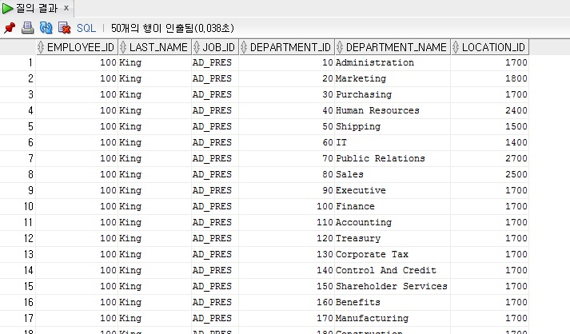
문제1) EMPLOYEES 테이블과 DEPARTMENTS 테이블을 Cartesian Product(모든 가능한 행들의 Join)하여 사원번호,이름,업무,부서번호,부서명,근무지를 출력하여라.

Slide 61
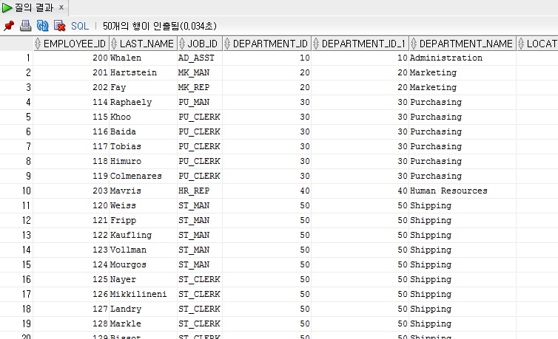
문제2) EMPLOYEES 테이블에서 사원번호,이름,업무, EMPLOYEES 테이블의 부서번호, DEPARTMENTS 테이블의 부서번호,부서명,근무지를 출력하여라.

Slide 62
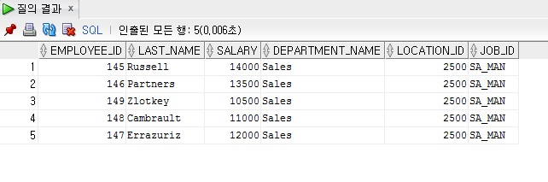
문제3) EMPLOYEES 테이블과 DEPARTMENTS 테이블의 부서번호를 조인하고
SA_MAN 사원만의 사원번호,이름,급여,부서명,근무지를 출력하라.
(Alias를 사용)

Slide 63
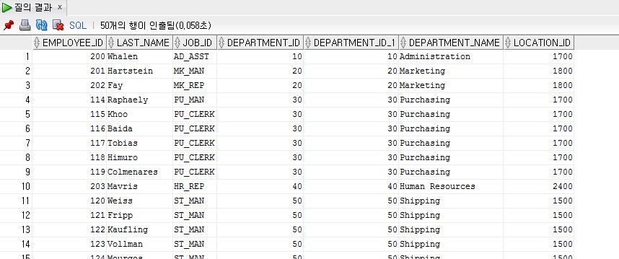
문제4) EMPLOYEES 테이블과 DEPARTMENTS 테이블에서 DEPARTMENTS 테이블에 있는 모든 자료를 사원번호,이름,업무, EMPLOYEES 테이블의 부서번호, DEPARTMENTS 테이블의 부서번호,부서명,근무지를 출력하여라
(Outer Join)

Slide 64
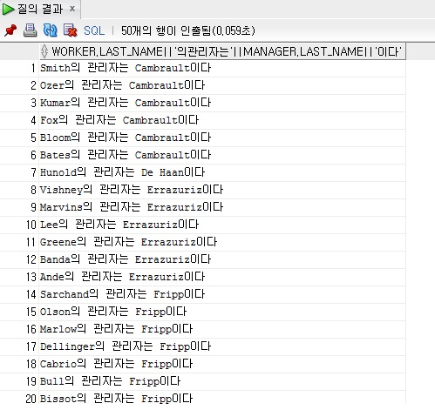
문제5) EMPLOYEES 테이블에서 Self join하여 관리자(매니저)를 출력하여라.

Slide 65
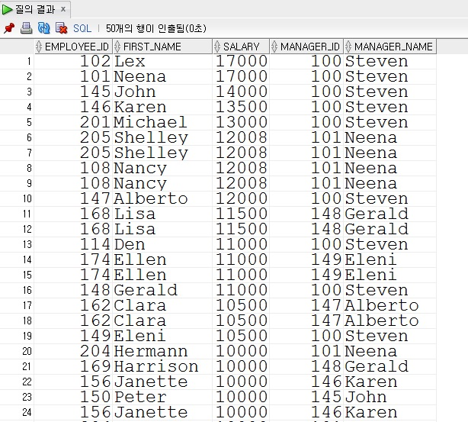
문제6) EMPLOYEES 테이블에서 left join하여 관리자(매니저)를 출력하고
매니저 아이디가 없는 사람은 배제하고 하향식으로 급여는 역순으로 출력하라.

Slide 66
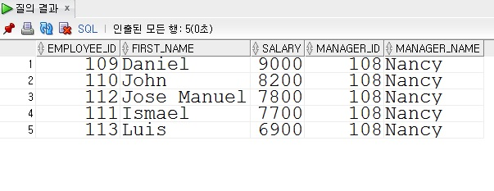
문제7) EMPLOYEES 테이블에서 right join하고 관리자(매니저)가 108번
상향식으로 급여는 역순으로 출력하라.

